Slide 1
Answering Door Bell
Aditya Khemka and Aniket Sarkar
DBMS English School , Jamshedpur (Jharkhand)

Slide 2
Thankyou
This mentorship programme is an unforgettable event and we take back many learnings from it .
Before we continue, we would like to thank Adobe India for their support and initiative.
We would also want to thank all our mentors for their help and support . We would want to appreciate the mentor’s willingness to help and their guidance in every part of the journey. The advice and experience of the mentors have been tremendously helpful.
We would also take this opportunity to share our learnings from the programme. We truly appreciate the confidence Adobe showed in us by giving us a chance to patriciate here. With this programme, we take away with ourselves such skills and values which will surely help me us the coming days …..

Slide 3
PROBLEM
STATEMENT
How we identified the problem
.
While having a conversation with our chairperson, Mrs Bhanumathi Neelakantan (aged 83), we came to know of a very common problem suffered by aged people – many a times they are unable to timely attend their guests at the door .

Slide 4
THE UTOPIA
Solution 1
An app / service to communicate with guests
Solution 2
After the brainstorming session, we came to a ground that communicating with the guest could be the best approach.
To communicate via mobile phones
Solution 3
To display messages to the guests

Slide 5
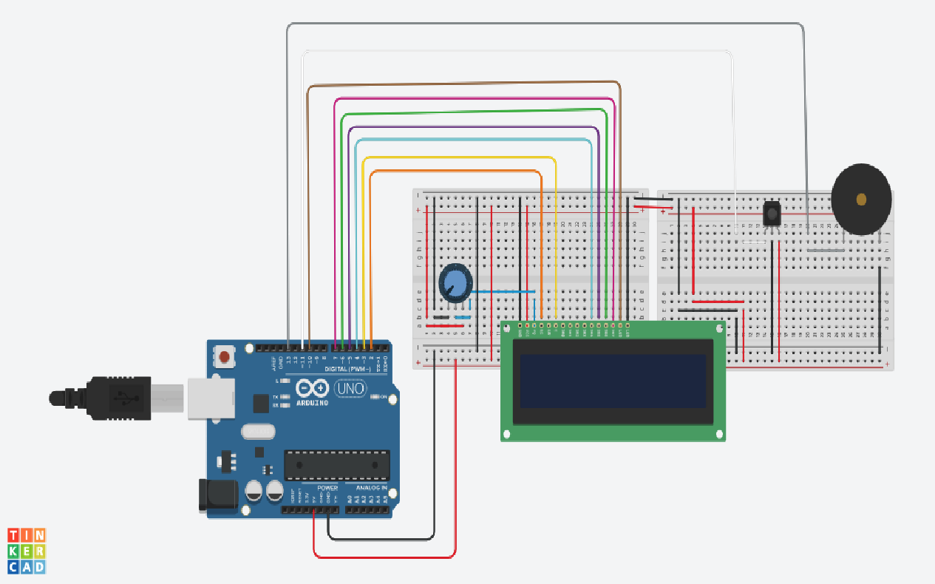
The Answering Door Bell
The third option fits the best and so the ADB was born – a simple device that could display messages to the guest using a remote ….

Slide 6
Working of the doorbell
Step 1
On hearing the doorbell, the user presses a button on the remote
Processing
(Each button is programmed to display a specific message)
The doorbell consists of a LCD display (outdoor unit, placed near the doorbell) and a remote to control the display
Step 2
The specific message is displayed on the screen outside

Slide 7
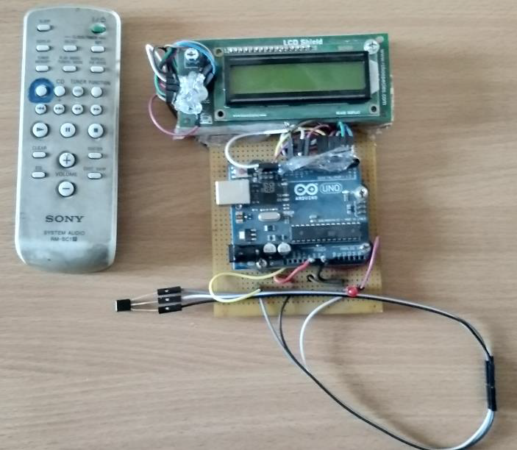
Review of the chairperson
The first prototype was installed in the house of Mrs. Bhanumathi Neelakantan. Taking into consideration the feedback by Mam and other people, we identified some lacking features in the first prototype and they were eliminated in the upcoming prototypes …

Slide 8
Room for improvements
The Version 1 of the doorbell lacked the following features
Limited messages
No camera
The first prototype could display only three messages. Mam suggested to increase the number of messages and also to add messages in Hindi.
Unless knowing who’s the guest, it is difficult to display an appropriate message

Slide 9
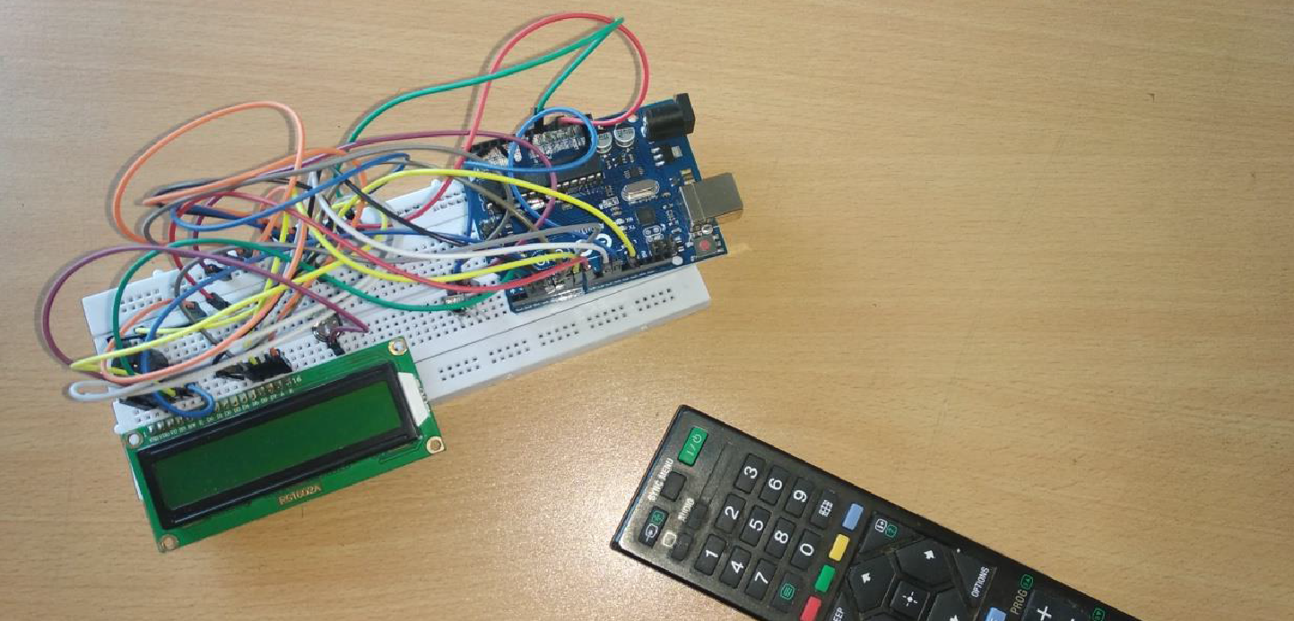
Doorbell V1.2 (prototype 2)
Upgrade 1
Added more messages. Now the device could display 10 English and 2 Hindi messages
Upgrade 2
The device could now display the user’s name-card and address. Also it can be battery operated

Slide 10
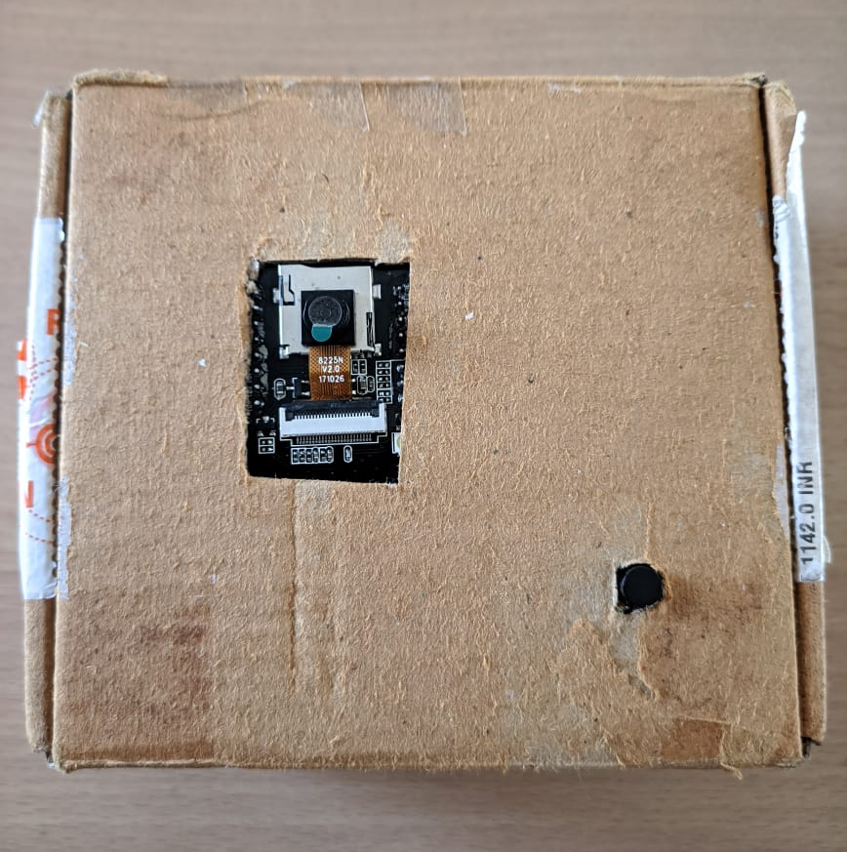
Doorbell V2
The third prototype adds a camera to the doorbell and an app to stream the camera. The third prototype also enables to unlock the door with the app . As soon as the doorbell is pressed , the user receives a notification in the app

Slide 11
Working of the device:
Step 1
Step 2
Step 3
Button / Switch of doorbell is pressed by guest
Image captured and processed by camera
User notified . Image of guest also updated in app

Slide 12
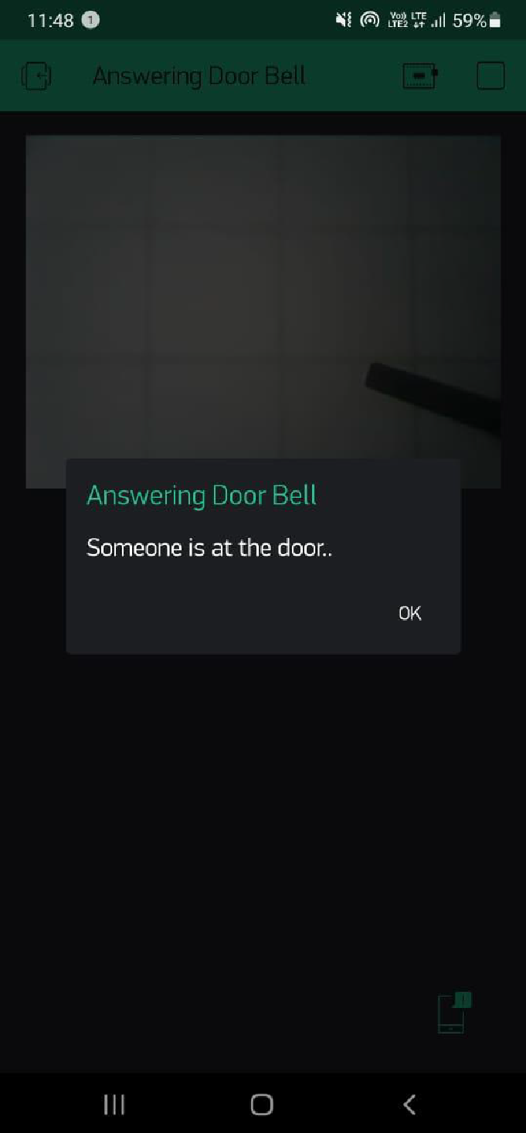
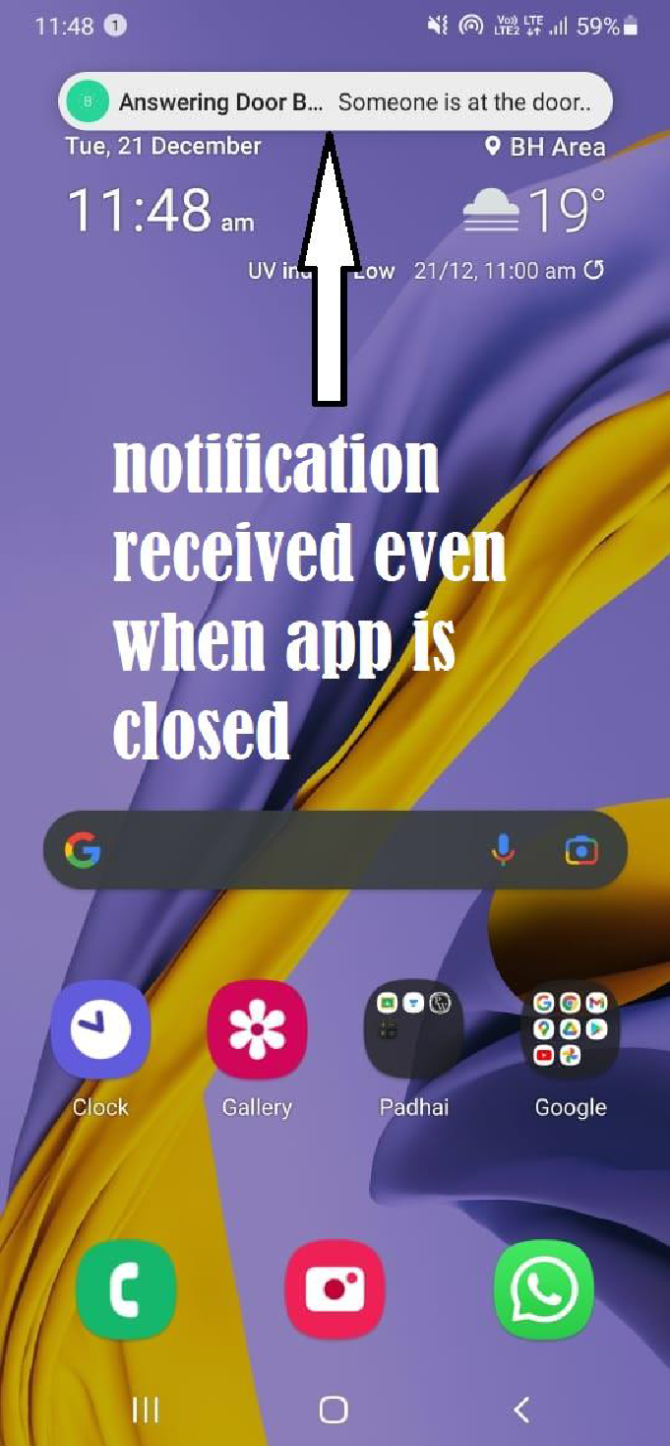
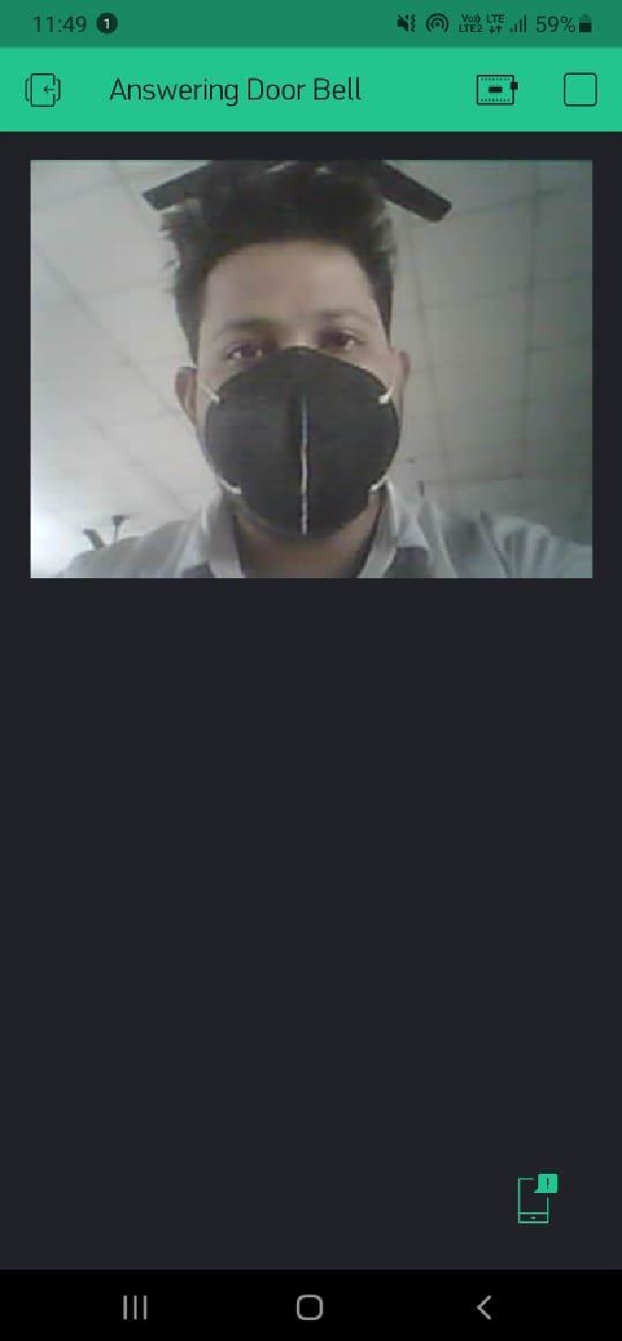
App
An android app to see who’s on the door and also to receive notifications
Notification received in app
Notification received even when app is closed
Image captured by camera

Slide 13
Timeline of development
Prototype 1 – V 1.0
1
Could display only three messages and was a wired solution
Prototype 2 – V 1.1
2
Could display a dozen messages (some in Hindi). Also, it can be battery operated, thus eliminating the need for 24/7 electricity supply
3
Prototype 3 – V2
This added a camera to the device so the user can see who’s at the door

Slide 14
Future Updates
Speaker
Intruder alert
We’re working to add a speaker to the device so as to enable to readout messages in Hindi or English or to enable user to communicate directly with the guest .
We’re also looking ahead to add intruder mode so that the device may also act as a security cam instead of just a doorcam .
Based upon the feedbacks and suggestions received by various people, we are working to expand some features of doorbell
Voice commands
Face recognition
We’re also working to integrate it with smart assistants (such as Alexa or Google assistant ) which will add voice commands to the device
Face recognition systems would make it even more easier for people

Slide 15
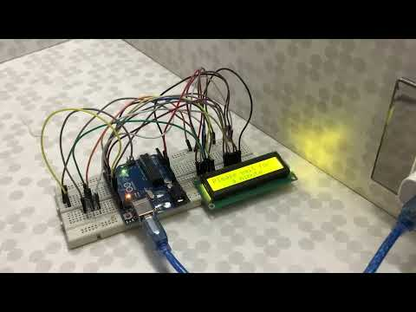
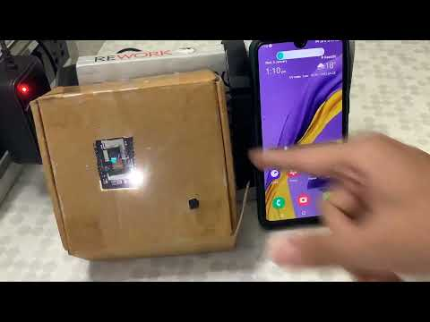
Demonstration
Documentation
Version 1
demonstration
Click here to view PDF
Version 2
demonstration

Slide 16
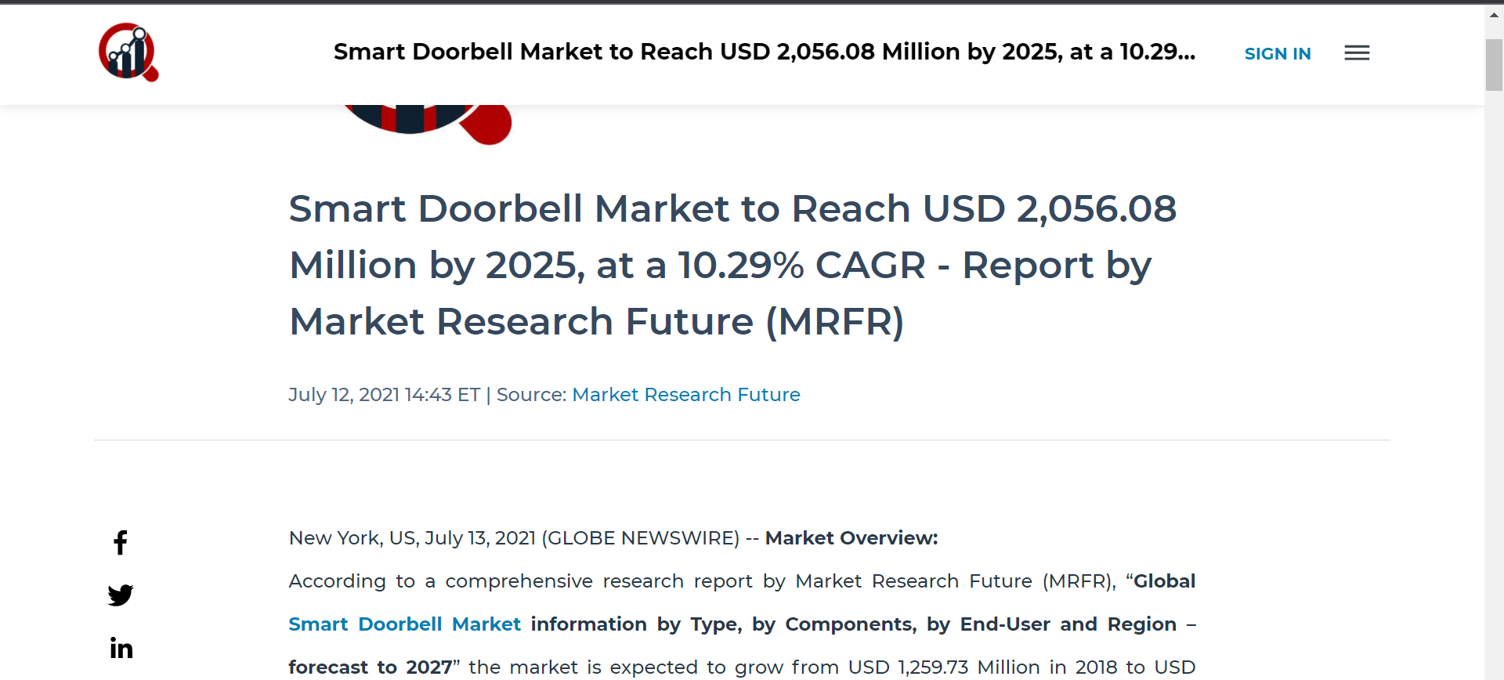
Market Size
Smart Doorbell Market to Reach USD 2,056.08 Million by 2025, at a 10.29% CAGR - Report by Market Research Future (MRFR)
(reference)
Article by Global News Wire on the progress of doorbell industry

Slide 17
Customer Base
Though it started only as a solution to a common old age problem, it can also be monetized and served to a larger customer base
Increasing Demand
Market
Indian Market
The major market of such products is in Europe and North America. Currently US and Canada are countries with best adoption rates of such products
Currently India makes a very small percentage of the market of such products but with the increase in digitalization and smart cities, adaptation rates will surely see a rise.
features such as flexibility with high security, ease of installation, remote access, and quick alerts attarct new users

Slide 18
Alternative products in the market
Features
Answering Door Bell
Other smart doorbells (ex Google Hello etc. )
Video Streaming
✓
✓
Wireless technology
✓
in most devices
Remote door unlock
✓
Mostly unavailable
✓
Made in India
None
Display for guest
✓
None
~ ₹2,000
₹16,000 to ₹46,000
Price

Slide 19
Thankyou

